Slide 1




Facilitator TRaining
DUBLIN.EDUCITIES PlatFORM
Training programme
CC BY-NC-SA: This license allows reusers to distribute, remix, adapt, and build upon the material in any medium or format for noncommercial purposes only, and only so long as attribution is given to the creator. If you remix, adapt, or build upon the material, you must license the modified material under identical terms.
The European Commission's support for the production of this publication does not constitute an endorsement of the contents, which reflect the views only of the authors, and the Commission cannot be held responsible for any use which may be made of the information contained therein.

Slide 2
Content
1) Overview of the training course, aims and objectives
2) Introduction to the CONNECT model and learning approach
3) Overview of the CONNECT web platform and tools
4) The learning cycle (8 principles of connected learning)
5) Themes and topics (5 thematic areas)
6) Role and tasks of facilitators
7) Guidelines: facilitating personal learning projects of citizens remote from learning
8) Practical exercises
9) Optional topic. Specific issues which may arise in local context.
10) Methods of empowering and building learning capacities in low achievers

Slide 3

1) Overview of the training course, aims and objectives

Slide 4

Focus
Training facilitators for the Educities Platform
Target groups
Facilitators are “curators of the learning process”
Learning outcomes
Provide the necessary knowledge and skills to facilitators
Notes:
This training course aims at training a number of facilitators, in order to make the platform operational and populate it with members and content. Facilitators support learners in making inquiries about a subject or topic. However, it is not so much about facilitators being ‘experts’ in the many digital tools and technologies available and imparting that knowledge to others; rather it is about them being facilitators of the learning process. Their role is that of catalysts, navigators, mediators and ‘curators of learning experiences’. The trained facilitators will support a broad variety of learners in navigating their learning, use and re-use learning resources and make connections to peers, mentors and experts in the area of their interest.
The training will provide the knowledge and skills necessary to facilitate online learning, including a good understanding of the pedagogy concepts / learning theories underlying “connected learning”, such as collaborative, distributed, inquiry-based and experimental learning.
In addition, in order to ensure effective work with low achievers, the training includes a number of modules, that are specifically dedicated to meet the needs of this target group. Those modules in particular comprise methods of empowerment and building of learning capacities in adults remote from learning.

Slide 5

TASKS AND TARGET GROUPS
Discussion
Connect
Initiating groups with learners and experts
Facilitating discussions in the groups
Advertise
Social
Developing articles for the blog
Welcoming new members
Notes:
Facilitators are members of the Educities platform that will have an extended role for community building:
By introducing to and guiding learners through the learning environment
By scaffolding learners’ experiences in life-relevant learning environments
This role will be accomplished through specific tasks like:
Developing articles for the blog
Welcoming new members and initiate discussions
Initiating groups
Facilitating discussions in the groups

Slide 6

2) Introduction to the CONNECT model and learning approach

Slide 7
CONNECT MODEL
The CONNECT project’s central idea: Connected Learning.
Connected learning:
  Combines personal interests, supportive relationships, and opportunities.
  Takes advantage takes advantages of the abundant access to information and social connections.
Notes:
The CONNECT project has focused on the idea of Connected Learning which, in this context, combines personal interests, supportive relationships, and opportunities. Connected Learning takes advantages of the abundant access to information and social connections in order to embrace the diversity of backgrounds and interests.

Slide 8
Lifelong learning
Adaptive
Natural
an economic and social response to changes in technology and the changing nature of employment and jobs
a natural activity which takes place regardless of participation in formal education programmes
Notes:
CONNECT focuses on Lifelong Learning for adults as an economic and social response to changes in technology and the changing nature of employment and jobs, emphasising the need for individuals to update their skills and knowledge to deal with these changes. Learning should be seen a natural activity which takes place regardless of participation in formal education programmes.

Slide 9
Digital literacy
Learning ecosystems
A focus on the importance of Digital Literacy, both for employment and as a tool for learning.
Important point:
  Constructing new knowledge
  Constructing social action.
People
Organisations
Interactions
Learning Ecosystems
Notes:
Digital Literacy:
The spread and importance of new technologies and digitalisation have led in the last decade to a focus on the importance of Digital Literacy, both for employment and as a tool for learning. Although frameworks for digital skills and competences are fast evolving, what is perhaps most important here is the emphasis on constructing new knowledge and social action (although judgements on what is constructive may vary).
Learning ecosystems:
The learning ecosystem is referred to as meaning “the people, structures, values, organisations, transactions that encompass experimentation, evaluation, evidence, policy change, resource allocation and attitudinal shift ...”
Two things stand out from this definition: firstly, the importance of people and transactions between them and secondly the changing nature of such an ecosystem.

Slide 10
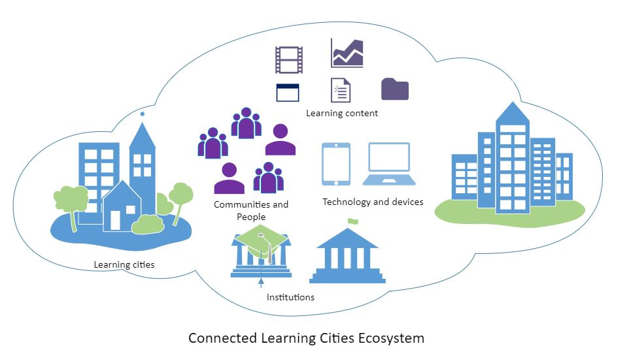
Connected Learning and
Learning Cities
The CONNECT project also aims at connecting learners with their cities within the context of learning opportunities.
Notes:
UNESCO defines a learning city as a city that:
effectively mobilizes its resources in every sector to promote inclusive learning from basic to higher education;
revitalizes learning in families and communities;
facilitates learning for and in the workplace;
extends the use of modern learning technologies;
enhances quality and excellence in learning; and
fosters a culture of learning throughout life.
In this context, the CONNECT project aims at connecting learners with their cities within the context of learning opportunities. Learners will be put in contact with institutions and learning programmes within their cities in order to broaden their learning experience and enhance their selves.

Slide 11
3) Overview of the CONNECT web platform and tools

Slide 12
Overview of the Connect platform
Tools
Platforms
  The News Feed
  The Members’ List
  The Groups
  The New Leaning Resources
  Education Institutions and Programmes
Platforms from: Greece, Germany, Spain, Romania, Ireland

Slide 13





https://www.dublin.educities.eu/
https://www.muenchen.educities.eu/
https://www.bucuresti.educities.eu/
https://www.https://motionacademy.es
(Powered by Motion Academy, Valencia)
https://www.kallithea.educities.eu/
Notes:
Facilitators are members of the Educities platform that will have an extended role for community building:
By introducing to and guiding learners through the learning environment
By scaffolding learners’ experiences in life-relevant learning environments
This role will be accomplished through specific tasks like:
Developing articles for the blog
Welcoming new members and initiate discussions
Initiating groups
Facilitating discussions in the groups

Slide 14
tools
01
02
03
04
05
NEWS FEED
MEMBERS
GROUPS
NEW LEARNING RESOURCES
EDUCATIONAL INSTITUTIONS & PROGRAMMES
Notes:
The news feed is here to keep you updated on the latest news of the communities, be it the creation of new groups of interest or new resources available. You can also upload articles or news yourself. The news feed will give you the opportunity to stay informed in order to keep the learners informed.
In addition, each platform contains a list of its members. This way, you have a direct link to the people who have the most relevant skills to help learners. This tool will be helpful especially when putting in contact different people with different background and when creating groups.
Next, one of the most important aspects of connected learning is this idea of connection. In order to connect experts with learners and beginners, it is important to give them a space to discuss ideas and share knowledge. This is what the Groups tool is aimed at: bringing people together.
On top of this, there are specific tools in certain platforms: first, the German platform contains a section that gathers new learning resources in order to make them more accessible to learners and facilitators. Second, the CONNECT project also aims at connecting learners with places to learn in their cities. This is why the Greek website contains this ”Educational Institutions & Programmes” section, to allow learners to get firsthand knowledge from specialized institutions and programmes around them.

Slide 15

4) The learning cycle (8 principles of connected learning)

Slide 16
  Interaction, collaboration
  Interaction, collaboration
  The learner is not alone
  The learner is not alone
  Practical, make and take ideas
  Practical, make and take ideas
  Coached action steps
  Coached action steps
Notes:
Interaction is a key element of connected learning. You have to keep in mind that connected learning is a collaboration. As such, learners come to you, as a facilitator, to help them achieve their goals. CONNECT is based on having the support of a facilitator which means a learner will not be alone, searching and deciphering the information. Not only is the facilitator there to bring a strong support to the learning experience but there is a whole community that is there to back them throughout their project. In order to help learners bring their projects to fruition, facilitators will provide practical ideas and information to the learners while also encouraging exchanges within the online community. The facilitator is like a coach for learners: helping them find the relevant information and applying it to their personal projects.
Connected learning IS NOT about delegating the creative process to the facilitator. The learner is a co-creator of his project, he will be active in the entire process. Being connected to a community of experts and beginners, the learner has access to a variety of experiences, knowledge and help in order to better the outcomes of their projects. They express their interests, decide the orientation of their project and what goals they want to set. As a facilitator, your job is to help them achieve said goals. To help this process, the connected learning space is not compartmentalized: learners have access to a wide variety of experts, beginners, other learners, facilitators, etc…

Slide 17
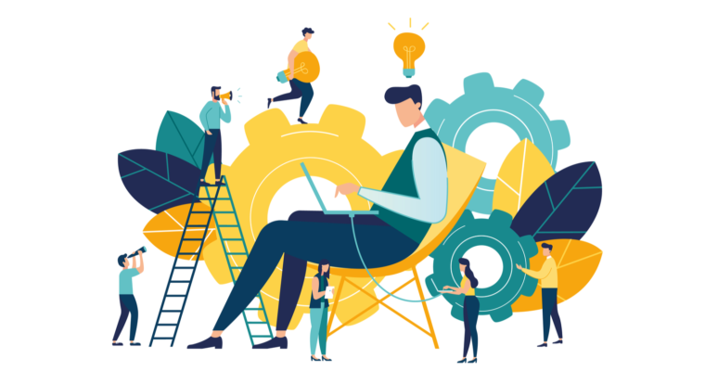
5) Themes and topics (5 thematic areas)

Slide 18
The themes
Citizenship in our local and global society
Being good at life in the 21st century
Form and function
Technology
Career, personal and professional advancement
Notes:
The “citizenship in our global society” theme aims at helping the learners participate in the world around us, challenging the norms, bringing people together with ideas. This theme includes social justice, politics, history, urban planning. The second theme “being good at life in the 21st century” will tackle questions relating to the day-to-day life in the 21st century. For example, you can find topics like cooking, routines/schedules, financial management, time management, nutrition, ergonomics. “Form and function” focuses on understanding the way something is made and will cover product design, graphic design, architecture, 3-D printing. “Technology” is based on making the knowledge society and learning how to use the digital tools efficiently and will cover coding skills, building mobile apps. Finally, “Career, personal and professional advancement” will help you set goals and knowing what steps are necessary to achieving said goals. It is centered on self-management, social skills, communication, project management.

Slide 19
6) Roles and goals of facilitators

Slide 20
What is a facilitator?
A person or a tool that makes something especially easier.
In a few and simple words, a facilitator is someone who finds the answer to a problem, by discussing and suggesting ways of doing things.
Notes:
The definition of a facilitator refers to a person or a tool that makes something especially easier. It is someone who helps to bring about an outcome, such as learning, productivity, or communication, by providing indirect or unobtrusive assistance, guidance, or supervision.
In a few and simple words, a facilitator is someone who helps a person or an organization do something more easily or find the answer to a problem, by discussing and suggesting ways of doing things.

Slide 21
Roles of a facilitator
Clairvoyant
Taskmaster
Praiser
Peacemaker
Motivator
Guide
Questioner
Bridge Builder
Notes:
Motivator: From the rousing opening statement to the closing words of cheer, you ignite a fire within the group, establish momentum, and keep the pace.
Guide: You know the steps of the process the group will execute from beginning to end and carefully guide the participants through each step in turn.
Questioner: You listen carefully to the discussion and quickly analyze comments to formulate questions that help guide a productive group discussion and challenge the group when appropriate.
Bridge Builder: You create and maintain a safe and open environment for sharing ideas. Where other people see differences, you find and use similarities to establish a foundation for building bridges to consensus.
Clairvoyant: Throughout the session, you are attuned to signs of strain, weariness, aggravation, and disempowerment, and respond in advance to prevent dysfunctional behavior.
Peacemaker: Although it is generally better to avoid direct confrontations, should it happen, you step in quickly to reestablish order and direct the group toward a constructive resolution.
Taskmaster: You are ultimately responsible for keeping the session on track. This entails tactfully cutting short irrelevant discussions, preventing detours, and maintaining a consistent level of detail throughout the session.
Praiser: At every opportunity, you should praise participants for good effort, progress, and results – praise well, praise often, praise specifically.

Slide 22
GOALS OF A FACILITATOR
  Mutual understanding
  Teamwork
  Shared responsibility
Notes:
The result that you should strive for, as a facilitator, is that:
Participants achieve a mutual understanding through disucssion and exchanges.
Their contributions are considered and included in the ideas, solutions or decisions that emerge.
Participants take shared responsibility for the outcome of the project.
In addition, a facilitator ought to ensure that outcomes, actions and questions are properly recorded and actioned, and appropriately dealt with afterwards.

Slide 23
7) Guidelines: facilitating personal learning projects of citizens remote from learning

Slide 24
1) Include learners’ voices
2) Meet the learners in their environment
3) Analyse and remove barriers
4) Enable progression

Slide 25
5) Use innovative and empowering methodologies
6) Use other learners as mentors
7) Increase diversity across connected learning spaces
8) Focus on the benefits for the learners

Slide 26

8) Practical exerciseS
The following section is targeted at potential facilitators who will use the Dublin Educities platform to work with community members, groups and volunteers. Facilitators will have experience of working within the community and may also have prior experience of youth or community development work. As facilitators, they will ideally structure a workshop session around the following key elements of the platform:
Step 1: Demonstrating user registration Step 2: Setting up personal profile Step 3: Navigating the platform Step 4: Making use of the platform features Step 5: Demonstrating how to access resources Step 6: Making friends and building restorative communities The facilitator should ensure that each user can access the platform and can follow each step as it is being demonstrated during the workshop.

Slide 27
Step 1: Demonstrating Registration Process
In order to demonstrate to users how the registration process works, it is a good idea to take them through the specific steps. Enter the following url in your Internet browser: www.dublin.educities.eu
Notes:
In order to create a group, open the educities website and:
Go to “Community”, then Create Group.

Slide 28
Within the log in/registration panel, click on the “registration” icon, as indicated by the arrow below.
Notes:
Enter the necessary information.
Click “Create Group and Continue”
Start the discussion within your group and enjoy the exchanges!

Slide 29
Complete the details as per the form and complete the registration step

Slide 30
The user will receive an email to the registered address. It is important that they check their inbox filters as this email may be sent to their spam box. Once the user has activated the account, they are ready to use the site.
During the workshop, it is useful to take the users through each of these steps. While it may seem very straightforward, the user will benefit from seeing these specific parts of the registration process.

Slide 31
Step 2 Adding to the User Profile
The more that the user can personalise their account, the better.
During the workshop, demonstrate to the users how they can add information to their Profile, including image, etc.
Be sure to ask questions in relation to the types of interests that they would like to include in their individual section.
This can be updated at any stage and can be useful as users engage with the platform more regularly.

Slide 32
Step 3: Navigating the Platform
There are a number of tool bars and menus to make it easy to get around the platform.
As facilitator, it is helpful to the workshop participants to see how these tool bars can be used.
Once they have become active on the site, they will get more used to seeing notifications from friends or from groups that you have joined.
During the workshop, give examples of these types of notifications. For example, you can like a post or accept a friend request and you can show how the number of notifications increase.
As with other platforms, users will see that they can share, like, offer feedback and send direct messages to friends or colleagues.

Slide 33
Step 4: Using the Features
During the workshop, the facilitator should have content ready to present to the participants. The users can see how simple it is to add new materials, whether it be comments and feedback, videos and photographs or a blog post on a new topic.
The users can understand that once they have completed registration and profile update steps, they can then navigate through the platform.
Users can see that a wide range of groups have already been established for their purposes. Through the workshop, it is important to highlight the manner in which the platform can be used to share information and become a repository for resources.

Slide 35

Step 4: Using the Features
Some important notes to share with the users during the session:
If the Group is listed as Public, the user can join it and immediately see the contents and the previous posts.
Users can create a specific group and make use of this as a means of developing new ideas in relation to Restorative Practice or any associated activities in their work or social life.

Slide 36
A community blog is also accessible here, where community announcements can be posted for all to see.
Updates to the platform or new features will also be explained here.

Slide 37
Step 5: Demonstrating How to Access Resources
As facilitator, there are further features that can be demonstrated, including how to access resources that are stored on the platform.
Many of the groups have loaded specific resources onto the platform. Many of these have been added in order to build access for group members to information associated with Restorative Practices.
The facilitator can highlight how users can create resource repositories, for example if a user has participated in a learning workshop recently, the presentations can be uploaded with the aim of keeping any conversations going, but this time in a safe online space.

Slide 39
Step 6: Making Friends and Building Restorative Communities
As the platform expands its membership, the facilitator can note to the workshop participants that the community will grow accordingly.
The facilitator should note that there are people joining who share common interests in aspects of youth work, sports development, living and working in the north inner city, etc.
Much like other platforms, participants have the option of becoming friends and encouraging their colleagues to engage. This will allow all users to keep up to date on any new posts or activities that they are involved in.
The facilitator should sign off on the session reminding the users that the platform focus is on promoting the learning, sharing new ideas while at the same time promoting fun and enjoyment as the learning occurs.

Slide 40
9) Supporting Learners

Slide 41
Tips for Developing Learner Interests
Encourage curiosity and exploration
Initiative, effort support.
Be Led by Learners
Creative activities and decision-making.
Use Technology for Creative Production and Expression
Initiate, teach and disseminate.
Notes:
Encourage curiosity and exploration
Take the initiative to learn about and support diverse learner interests to better understand their priorities and values.
Make a conscious effort to connect your learners to other organisations that might deepen their interests.
Within your learning spaces, support skill development through learning pathways, course sequences, peer mentoring or leadership opportunities.
Be Led by Learners
Employ activities that have no right answer. Creative activities linked to storytelling can allow your learners to express themselves in the production of a project.
Establish a learner council and incorporate the input in programmatic and strategic decisions to show your commitment to the input. Actively look for places to compromise and explain decisions.
Use Technology for Creative Production and Expression
If the learners are new to tech, make sure to bridge from the familiar to the unknown. Let the digital tools bring a concept to life only when it has been started in a mode or medium your learner is comfortable with.
Use digital technologies to create projects that can be worked on in person and online, individually or collaboratively.
Think about the potential audience for the learner’s work. Online tools and forums can enable low-barrier ways to produce or share original outputs, such as designs, tracks, text​, art or performances.

Slide 42
Tips for Building Supportive Relationships
Cultivate peer relationships
Collaborate, support and build trust.
Create a Safe Space
Respect, feedback and contribute.
Work Openly and with Shared Purpose
Set goals, share and showcase.
Notes:
Cultivate Peer Relationships
Encourage collaboration based on shared interests and skills instead of established social circles. When a member of your group is asking for help, give their peers a chance to volunteer their own knowledge and expertise.
When assigning group projects, provide support for online collaboration where the learners can share work.
Talking openly about your interests is one way to cultivate trust and build a relationship. Dedicating time to learning and listening to your learners can also model the importance of peer-to-peer learning.
Create a Safe Space
Treating learners with respect, giving them space to express their emotions without judgment, and really listening to them are most likely to help them feel safe and supported.​
Ask your learners what they need from you to feel more comfortable and be willing to make those changes. It’s easier to broker an entry point for them if you know what they like and how they learn best.
Enable multiple ways to contribute, yet be willing to let your learners observe while they get more comfortable. Balancing the tension between wanting someone to participate and wanting to give them space to join in is challenging but can build trust.
Work Openly and with Shared Purpose
Online communities can be important parts of your learner groups. Allow some external sharing.
An end-of-course showcase can be held for an authentic audience of friends, family, trainers, policy makers, and the community, inspiring lifelong civic engagement.
When cultivating shared purpose, it can be helpful to have a collaborative project or event to encourage the learners to work toward a shared goal, allowing them to set and revise group goals.

Slide 43
Tips for Connecting to Future Opportunities
Translate Learned Skills
Language, mentoring and transparency.
Broaden Contexts for Learning
Learning achievements and online activism.
Create Opportunities for Collaborations
Credit, opportunities and connections.
Notes:
Translate Learned Skills
Often our new learners don’t have the language they need to translate what they have learned into other settings. Give them the language they can use on a CV or when talking about their skills with others.
If one of your learners is particularly taken by a topic or skill, invite potential mentors or professionals to illustrate how an interest might translate into a potential pathway.
Be transparent about your own career journey, struggles, and successes. Be sure to consider the ways in which your privilege might have reduced barriers for you.
Broaden Contexts for Learning
Examine whether awarding digital badges to recognise individual skills can be used meaningfully to communicate a connected pathway of learning experiences.
Support civic engagement through online communities and digital activism, helping your learners to use their voices to affect issues they care about.
Create Opportunities for Collaborations
Investigate how you can give credits and support for your learner’s work outside of the specific project-based activities.
Foster collaboration among educators, community based organisations and family networks to better connect our learners to existing opportunities.
Cultivate relationships with people within other learner spaces and in other interest areas. Invite these partners to co-lead a session with you or come to meet your learners as a way to help them make new connections.

Slide 44

Thank you for attendiing

